Slide 1

Intelligent And Weather Adaptive Street Lighting System

Slide 2

Project Description
This project will be used to transform lighting from a simple illumination source into a smart infrastructure of the project. IOT will help in connecting the internet with the lighting system.
Helps in sensing the environment and providing the lighting accordingly leading to efficient use of electricity and saving energy.
The project helps in controlling the street lights wirelessly in a centralized manner.
The lights can be switched ON and OFF anytime anywhere.
Also, the intensity of the light can also be controlled according to the level of darkness in the surrounding environment

Slide 3

Disadvantages Of The Existing System
Manual switching ON/OFF is done on the street lights.
More Energy Consumption due to the sodium vapour lamps.
Expensive, Since light is made to be ON the entire night.
More man power is required and periodic check is a must.

Slide 4

Advantages Of The Proposed System
Automated switching ON/OFF of the street lights
The light pollution is reduced.
The communication is made wireless.
The cost is significantly reduced because sodium vapour lamps are replaced by LED Energy is consumed more.
Man power is entirely eliminated

Slide 5

Admin
Data transfer to cloud
Block Diagram
Mode
selection
State of street light
Data transmission through nrf
Receiver street lights
manual
Automatic
Coordinator
Device
On / Off
Light intensity mapped with sensor data
LDR sensor
data

Slide 6

Hardware
ESP8266 12E module
NRF modules
LED’s (Street Lights).
LDR Sensor.

Slide 7

Project Highlights
Wireless sensor Mesh network with NRF modules.
Exploring cloud platform(IBM).
Working with API’s
Understanding the Http protocol
Monitoring the streetlight status and controlling through web App
Based on weather conditions, the intensity of street lights is also adjusted.

Slide 8
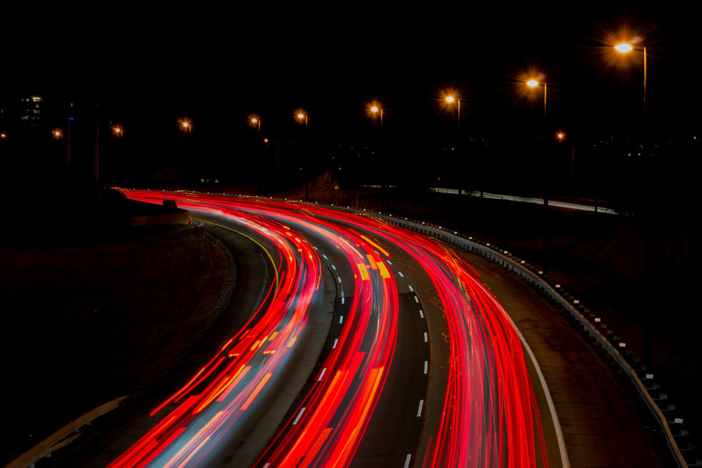
Future Scope
The project has scope in varied alternative applications like for providing lighting in industries, campuses and parking.
The project presents much more benefits which might over shadow the current limitations.
Keeping in sight the long run advantages and therefore the initial price would never be an issue because the investment recurrence time is extremely less.

Slide 9

Conclusion
Price effective
Eco-friendly
Safest Technique to Save Energy
Through this method the light status data is accessed from anytime and anyplace.

Slide 10


